Slide 1




Anantha sai
Batch- 239G

Slide 2

PROJECT ON
Web Scraping Explorative data analysis on CARS24
https://www.cars24.com/buy-used-maruti-cars-hyderabad/

Slide 3

Introduction
In this presentation, we will look into the data analysis process and give valuable information from the Cars24.Lets explore the data and gain a understanding of the dataset
My main objective is to give insights in two point of views
Customer point of view
Company point of view

Slide 4
Beautiful soup from BS4
Requests
LIBRARIES USED
Regular Expressions
Pandas
NumPy
Matplotlib
Seaborn

Slide 5






STEP
Graphical Representation
06
STEP
Analysis
05
STEP
04
Data Cleaning
Data Understanding
STEP
03
STEP
02
Data Frame
STEP
WEB SCRAPING
01

Slide 6
1
To begin our analysis we collected a comprehensive dataset from the CARS24 by using Web Scraping
2
The dataset consists of various attributes such as car make, model, Year and price .
With this dataset, we are equipped to perform a deep exploratory data analysis
and gain meaningful insights.
3
Understanding Data involves identifying and correcting inaccurate data in order to improve data quality for modeling purposes.
4
Duplicates and Typecasting. By ensuring the integrity of the data .
5
Uni-Variate analysis
Bi-Variate analysis
Multi-Variate analysis

Slide 7
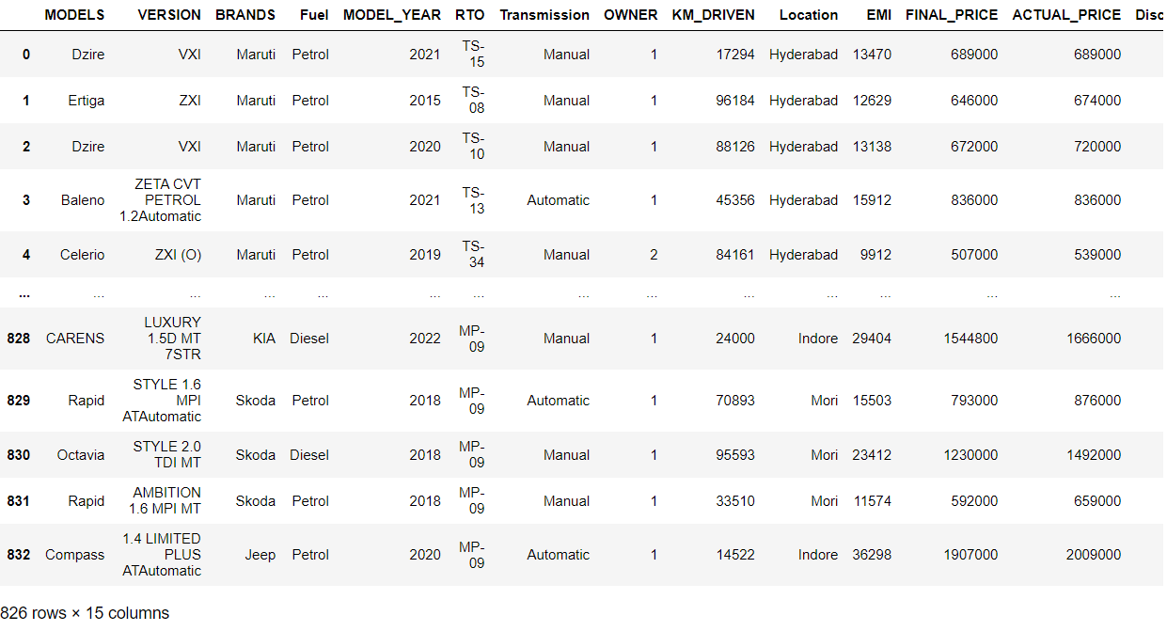

Data Frame

Slide 8
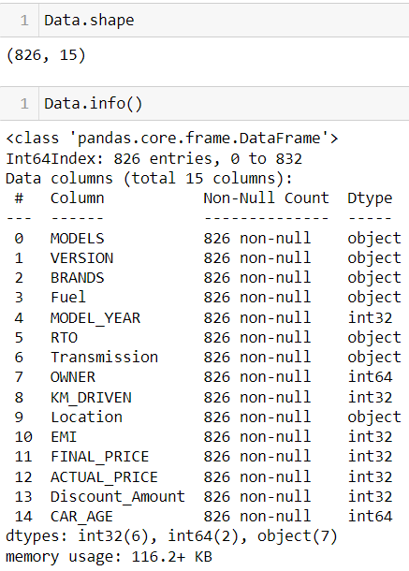
Data Set Info
In this, I’ve 826 records with 15 columns which includes D-types of 8 numeric and 7 categorical data .

Slide 9

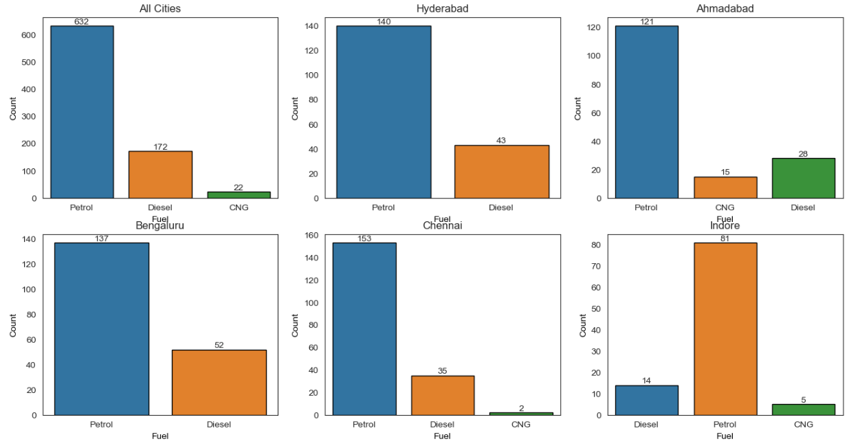
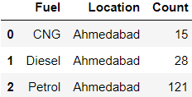

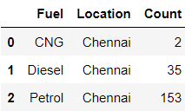
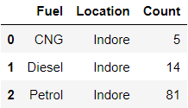
Fuel types
This Graph shows the types fuel cars from all cities

Slide 10
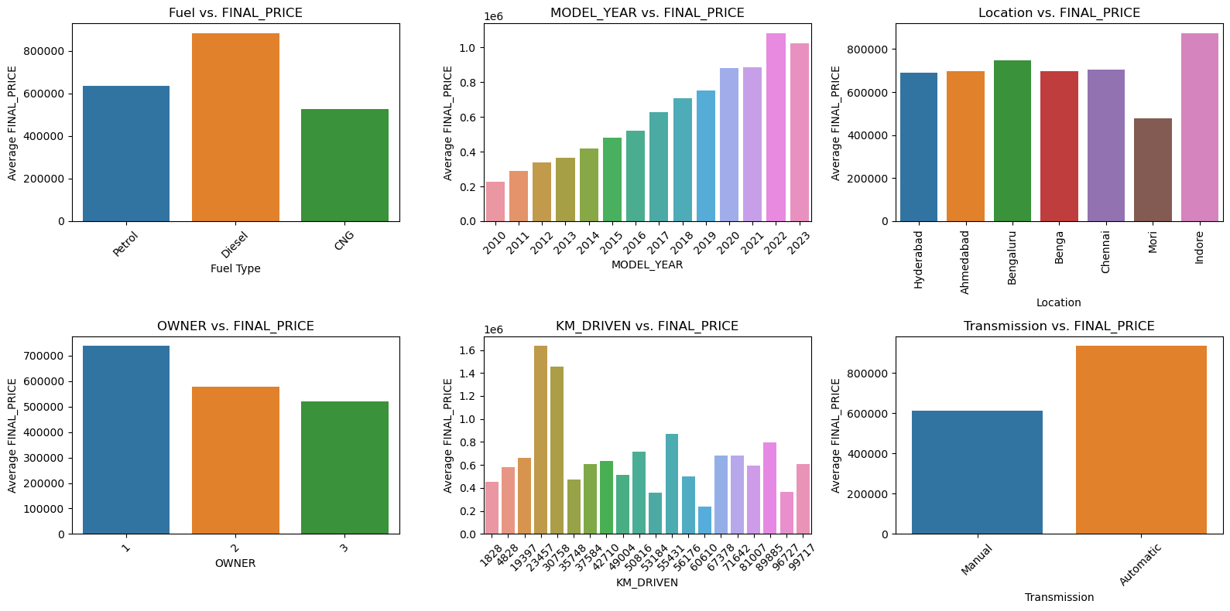
Price of cars based on different cases
1.Fuel vs. FINAL_PRICE
2. MODEL_YEAR vs. FINAL_PRICE
3. Location vs. FINAL_PRICE
4. OWNER vs. FINAL_PRICE
5. KM_DRIVEN vs. FINAL_PRICE
6. Transmission vs. FINAL_PRICE

Slide 11
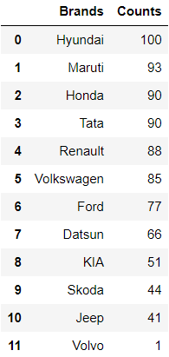
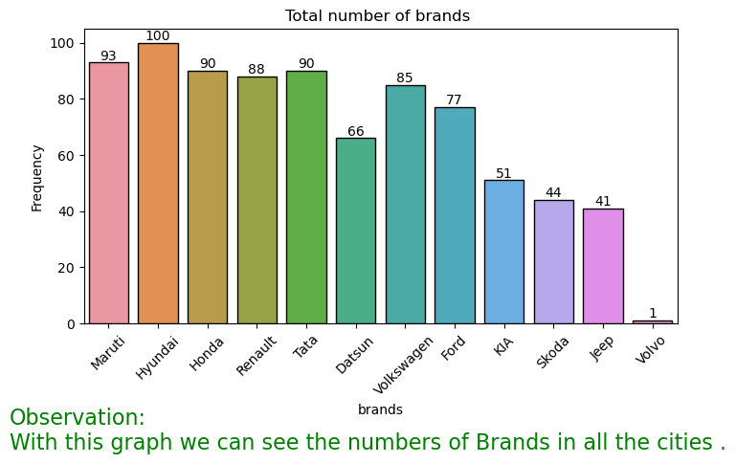
Count of Each BRAND in cities
This Graph shows the number of each brand from all the cities

Slide 12
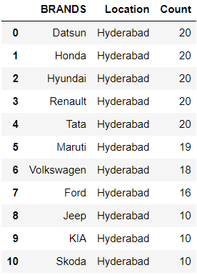
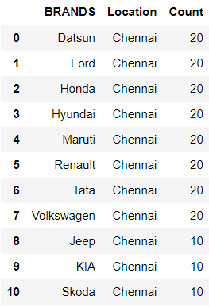
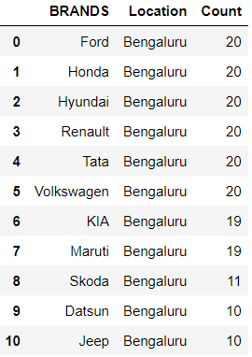
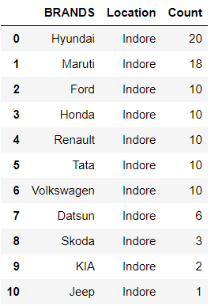
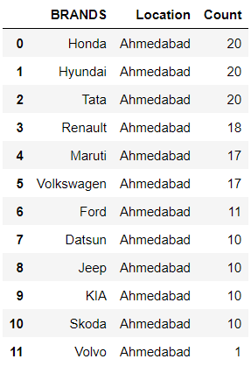
Count of BRANDS in each cities
This Graph shows the number of brand from each city

Slide 13
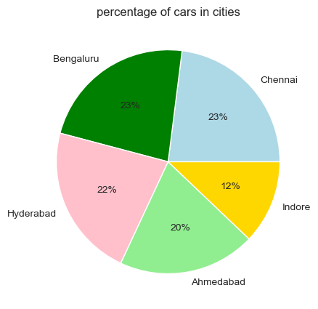
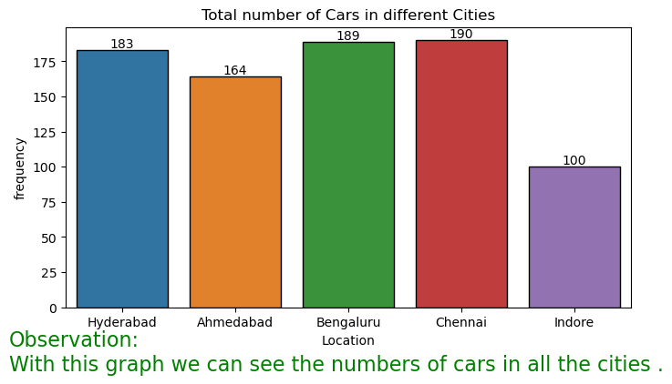
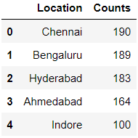
Count and Percentage of cars in all cities
This Graph shows the number of all modes from all brands in all the cities

Slide 14
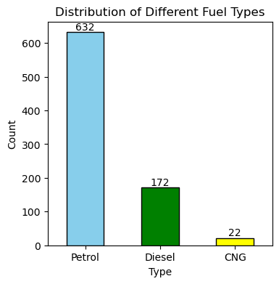
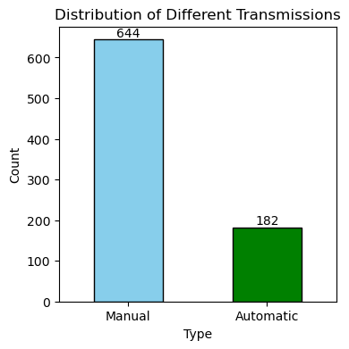
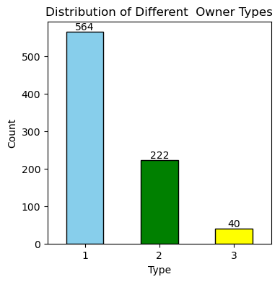
Count of Fuel types in all cities
Count of Transmission types in all cities
Count of Owner types in all cities

Slide 15
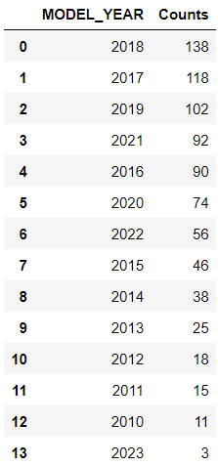
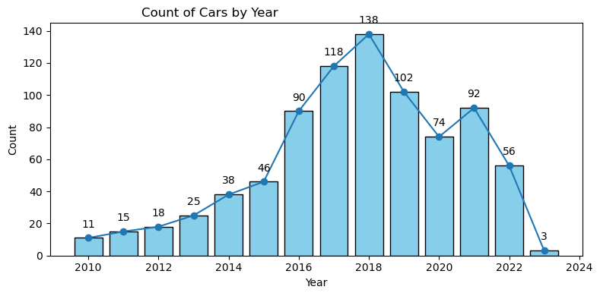
Count of cars are for sale in all cities

Slide 16
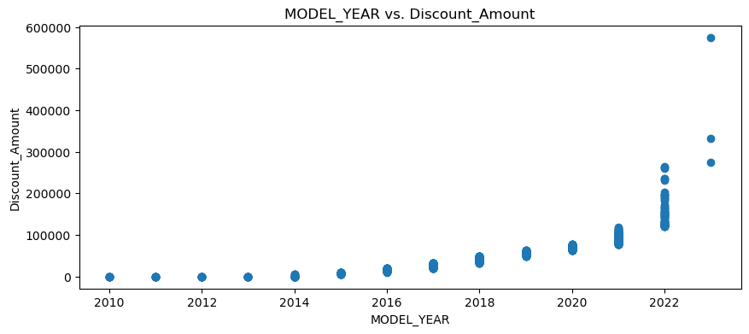
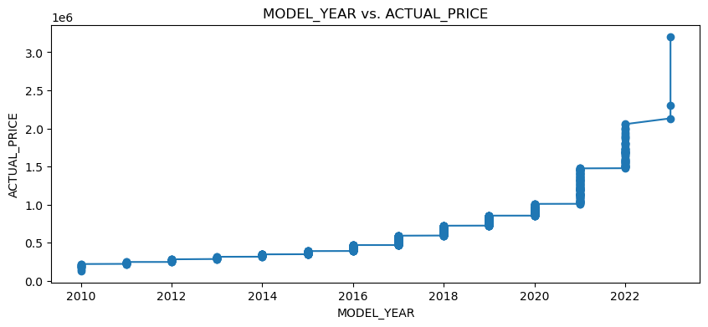
Variation of Discount according to the Model year
Variation of Actual price according to the Model year

Slide 17
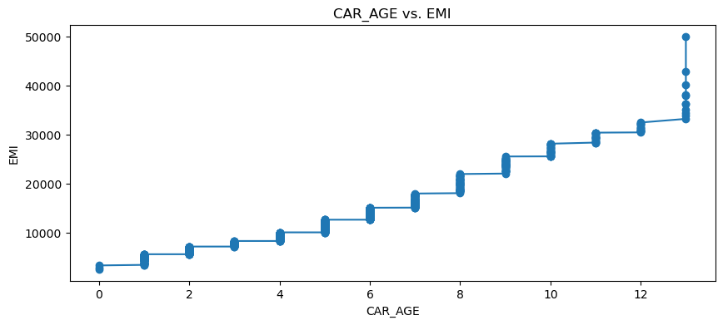
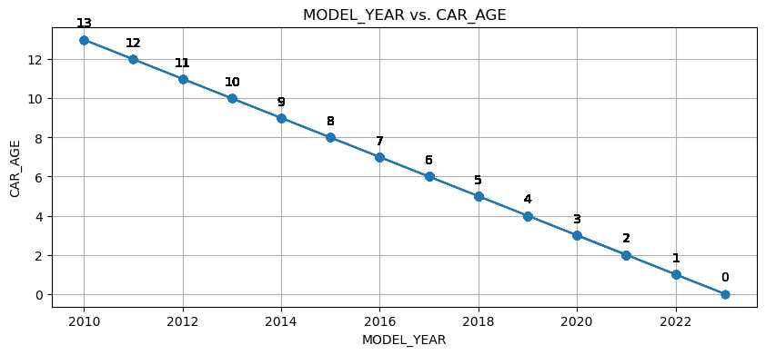
Variation of EMI according to the Car Age
How Car age in high based on model year

Slide 18
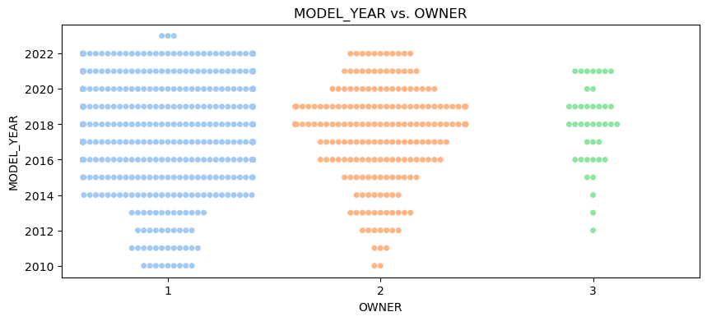
Variation of Owners based on the Model year

Slide 19
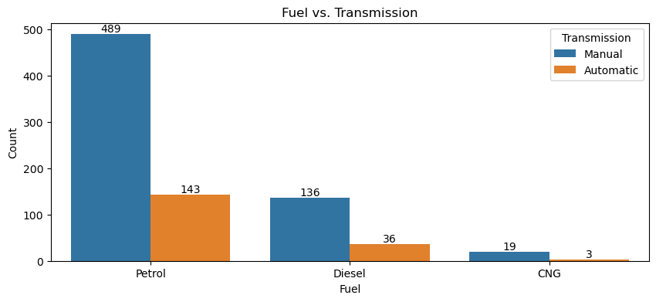
In this we can see Transmission based on fuel types

Slide 20
THANK YOU

